Slide 1
Exchange Hybrid – What, Why, and How
Thomas Stensitzki

Slide 2


Thomas Stensitzki
MCT Regional Lead
MVP Microsoft 365 Apps & Services
Author
Blogger
linktr.ee/stensitzki

Slide 3
Agenda
Why do we talk about Exchange Hybrid?
What is Exchange Hybrid?
Why do you need Exchange Hybrid?
How do you implement Exchange Hybrid?
Microsoft Teams and Exchange Server

Slide 4
Why do we talk about Exchange Hybrid?

Slide 5
Exchange Certifications
MS-203: Microsoft 365 Messaging
Microsoft 365 Certified: Messaging Administrator Associate
Microsoft 365 Certified: Enterprise Administrator Expert
MS-220: Troubleshooting Microsoft Exchange Online
Microsoft 365 Certified: Exchange Online Support Engineer Specialty

Slide 6
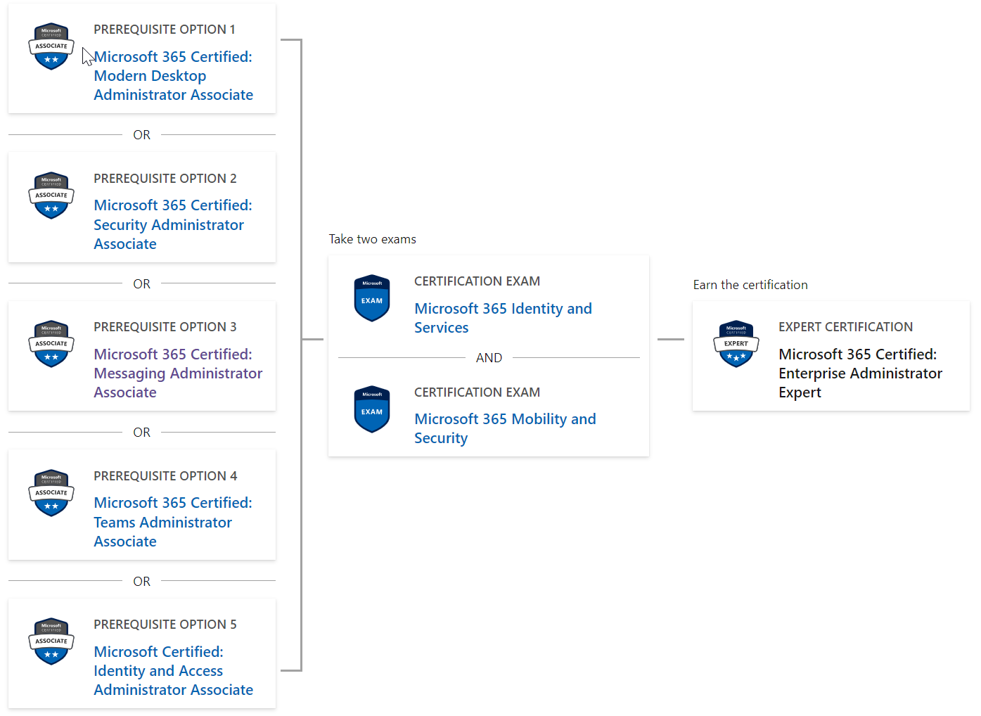

Slide 7
Who teaches M365 courses?

Slide 8
Exchange Training
Exchange knowledge is vanishing
Exchange Hybrid is essential when not using Exchange Online as a cloud-only solution
Exchange Hybrid configuration is simple, but tricky at the same time
Fixing Exchange Hybrid misconfiguration is simple, but the results take time to get into effect

Slide 9
What is the SLA statement for Exchange Online?
E.g., creating a new mailbox

Slide 10
What is the SLA statement for Exchange Online?
The SLA for most changes and activities in Exchange Online is 24h.

Slide 11
What is Exchange Hybrid?

Slide 12


Implementing Exchange Hybrid is simple.
Some undisclosed Exchange consultant

Slide 13

What is Exchange Hybrid
Trusted relationship between an on-premises Exchange Organization and Exchange Online
Hybrid connections for
Mail flow (SMTP)
Exchange access (HTTPS) for hybrid functionality
Hybrid Configuration Wizard (HCW) activates and configures the selected hybrid mode of operation
Supported Exchange Versions
Exchange Server 2013, 2016, and 2019
Microsoft 365
Hybrid Configuration
Exchange Online
On-Premises Exchange Organization

Slide 14
Two Variants – Three Modes of Operation
Exchange Hybrid Mode
Classic
Express
Minimal
Modern
Minimal
Full
Full
Variants
Operation Modes

Slide 15



Classic Full Hybrid
Microsoft 365
Hybrid Configuration
Active Directory Hybrid with Azure AD Connect
Exchange Hybrid option enabled
SMTP connection between on-premises and Exchange Online
Separate hostname (e.g., smtp365.company.com)
Additional public IP address
TLS certificate for hostname
Edge Transport Role in perimeter network (1)
Alternatively, direct inbound connection (2)
Exchange Online
Azure AD
SMTP
Perimeter Network
Company Network
On-Premises Exchange Organization

Slide 16
Classic Full Hybrid
Microsoft 365
Hybrid Configuration
Inbound HTTPS connection to Client Access Service
Internal Exchange Servers published by a reverse proxy system
Requires additional public IP address
Outbound HTTPS connections to Exchange Online
Exchange Server communication to Exchange Online
Exchange Online
Azure AD
HTTPS
SMTP
Perimeter Network
Company Network
On-Premises Exchange Organization

Slide 17
Modern Full Hybrid
Microsoft 365
Hybrid Configuration
Active Directory Hybrid with Azure AD Connect
Exchange Hybrid option enabled
SMTP connection between on-premises and Exchange Online
Separate hostname (e.g., smtp365.company.com)
Additional public IP address
TLS certificate for hostname
Edge Transport Role in perimeter network (1)
Alternatively, direct inbound connection (2)
Exchange Online
Azure AD
SMTP
Perimeter Network
Company Network
On-Premises Exchange Organization

Slide 18
Modern Full Hybrid
Microsoft 365
Hybrid Configuration
Outbound HTTPS connections to Exchange Online
Exchange Hybrid-Agent for Exchange Online to Exchange on-premises communication → Azure Service Bus variant
Exchange Server communication to Exchange Online
Install additional Hybrid Agents for redundancy
Exchange Online
Azure AD
HTTPS
SMTP
Perimeter Network
Comapany Network
On-Premises Exchange Organization

Slide 19


The Differences
Full
Full classic hybrid configuration, Exchange server published to the internet (SMTP/HTTPS) → permanent hybrid operation and Teams access to on-premises
Minimal
Hybrid configuration, without rich coexistence to migrate all on-premises mailboxes to Exchange Online → temporary hybrid operation for a few weeks / months
Express
Hybrid configuration, with Azure AD Connect Express settings, to migrate all on-premises mailboxes to Exchange Online → temporary hybrid operation for a few days / weeks
Full
Full Modern Hybrid configuration, for new hybrid setups based on Hybrid Agent deployment, with reduced hybrid functionality → permanent hybrid operation without Teams access to on-premises
Minimal
Modern Hybrid configuration, to migrate all on-premises mailboxes to Exchange Online → temporary hybrid operation for a few weeks / months

Slide 20

When do we call it Exchange Hybrid?
HCW configured inbound email delivery to Exchange Online
Exchange on-premises receives inbound messages from Exchange Online only
Direct Exchange Server to Exchange Online connectivity
Exchange Hybrid
Internet
Company Network

Slide 21
When do we call it Exchange Hybrid?
HCW configured inbound email delivery to Exchange on-premises
Exchange Online receives inbound messages from Exchange on-premises only
Direct Exchange Server to Exchange Online connectivity
Exchange Hybrid
Internet
Company Network

Slide 22

When do we call it Exchange Hybrid?
Manual configuration of mail flow using a third-party on-premises mail system
No Exchange Hybrid
Internet
Company Network

Slide 23
When do we call it Exchange Hybrid?
Email gateway solution handles mail flow between Exchange Online and external mail systems
On-Premises Exchange Server used for recipient management
No Exchange Hybrid
Internet
Company Network

Slide 24
Can you think of other "hybrid" options?

Slide 25

Questions?

Slide 26
Why do you need Exchange Hybrid?

Slide 27
Why Exchange Hybrid?
Coexistence between an on-premises Exchange Organization and Exchange Online
Mailbox migration to and from Exchange Online
Seamless public folder migration to Exchange Online
Microsoft Teams with on-premises mailboxes (calendar access)
Transition from an on-premises Exchange Organization to Exchange Online
Optimal migration experience for end users
Offboarding from Exchange Online to an on-premises Exchange Organization

Slide 28
Why Exchange Hybrid?
Centralized mail flow for use of on-premises email solutions with user mailboxes in Exchange Online
Gateway-based S/MIME decryption/encryption, email disclaimer, archiving, journaling, …
Hybrid mail flow providing email relay functionality for on-premises legacy applications and devices with
No access to the internet
No support for TLS protocols 1.0 or 1.1
No support for SMTPAUTH user authentication
No support for SMTP modern authentication

Slide 29
Centralized Mail Flow
Internet
Company Network

Slide 30
Questions?

Slide 31
How do you implement Exchange Hybrid?

Slide 32
Exchange Hybrid Requirements
Know the differences of the Exchange hybrid variants and modes of operation available
Know the selected mode of operation for your Exchange organization and hybrid requirements
Have your on-premises Exchange organization ready for hybrid configuration
Install latest Exchange Server Cumulative Updates on all Exchange servers, including Edge Transport servers

Slide 33
Exchange Hybrid Requirements
Have required IP addresses & DNS hostnames for the Exchange namespace set up
Verify inbound connectivity to your Exchange organization using Microsoft Remote Connectivity Analyzer
https://testconnectivity.microsoft.com/
Have Edge Transport TLS certificates installed on internal an Exchange Server for selection by HCW, when using Edge
Do NOT enable this certificate for any Exchange service
Enable Exchange Hybrid option in Azure AD Connect first
Notes:
https://testconnectivity.microsoft.com/

Slide 34
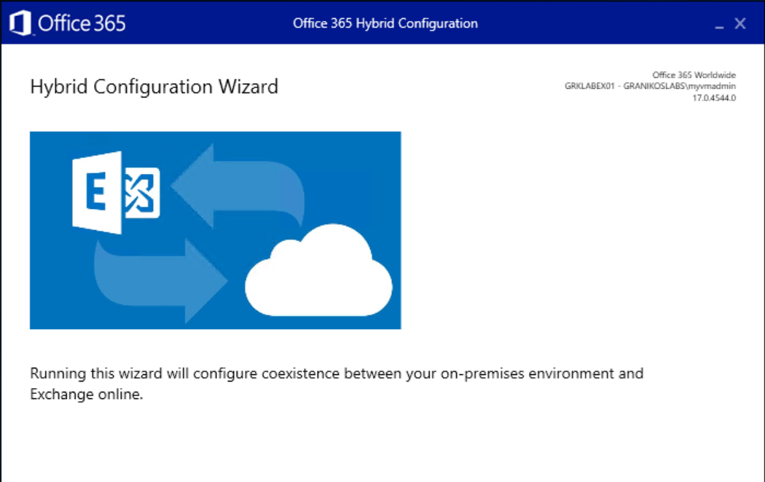
Hybrid Configuration Wizard
Click-2-Run Setup
https://aka.ms/HybridWizard
.application file type requires mapping to Internet Explorer
Note the HCW version information
Current: v17
HCW is updated regularly
HCW downloads a newer version automatically when started
HCW configuration steps vary depending on your Exchange Organization configuration

Slide 35
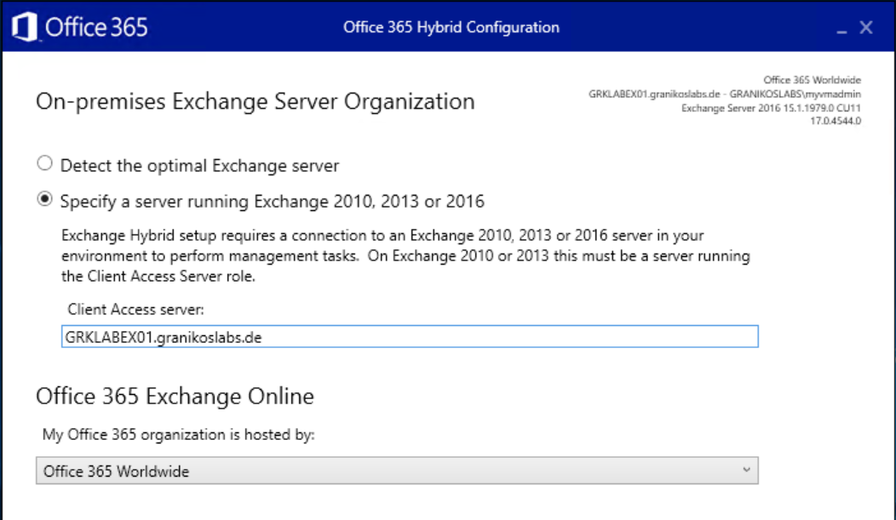
Hybrid Configuration Wizard
HCW detects the optimal Exchange Server for configuration automatically
Specify a CAS server manually, if needed
Select the appropriate Office 365 target infrastructure
Office 365 Worldwide is the default for commercial customers

Slide 36
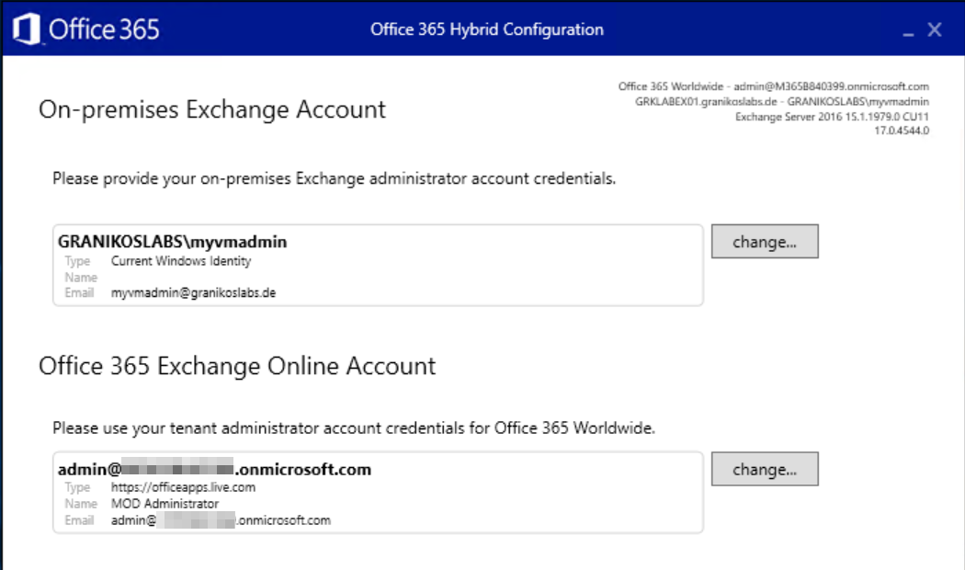
Hybrid Configuration Wizard
HCW connects to on-premises Exchange and Exchange Online to gather the current organizational configuration
Adjust credentials as needed

Slide 37
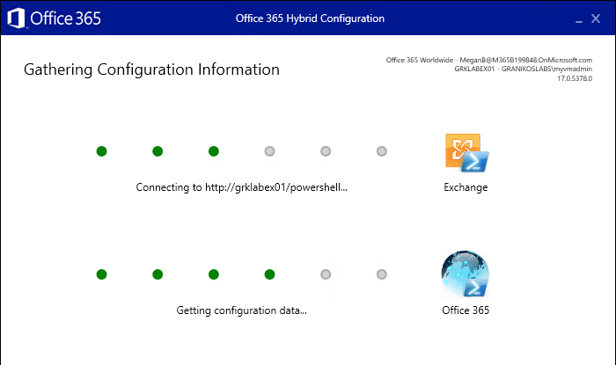
Hybrid Configuration Wizard
HCW connects to on-premises Exchange and Exchange Online to gather the current organizational configuration
Adjust credentials as needed
→Check, if WinRM allows Basic Authentication

Slide 38
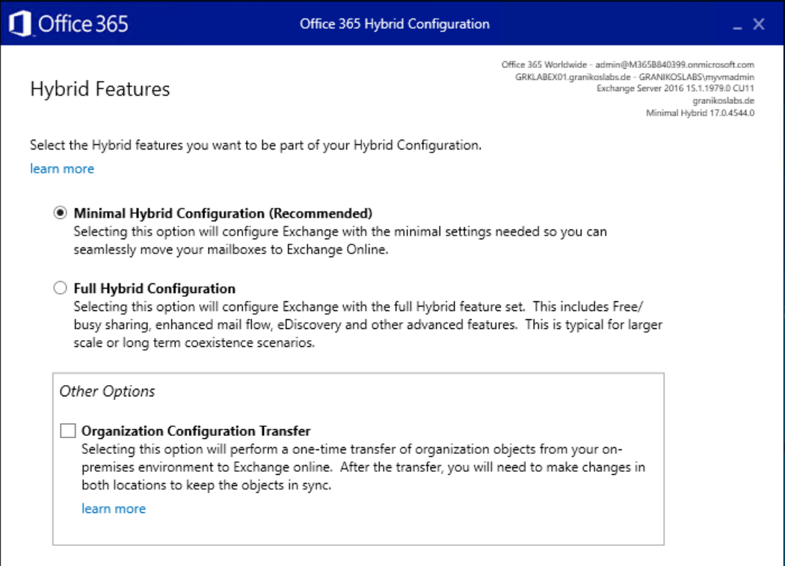
Hybrid Configuration Wizard
Select hybrid features to configure
Minimal Hybrid
Full Hybrid
Enable Organization Configuration Transfer
One-time transfer of selected configuration objects
Available objects depend on the on-premises Exchange Server version
Hybrid Organization Configuration Transfer Documentation

Slide 39
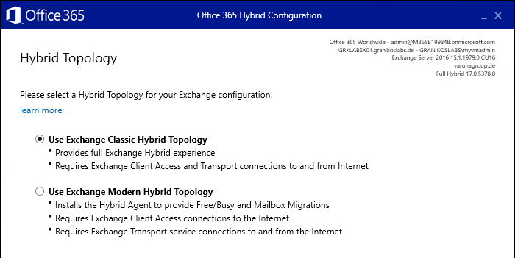
Hybrid Configuration Wizard
Select Hybrid Topology
Exchange Classic Hybrid
Exchange Modern Hybrid
Modern Hybrid uses the Modern Hybrid Agent
Azure Application Proxy-style component using HTTPS outbound connectivity only
Automatic download and installation
Hybrid Updater
Hybrid Agent
HCW uninstalls and unregisters the Modern Hybrid Agent when switching from Modern Hybrid

Slide 40
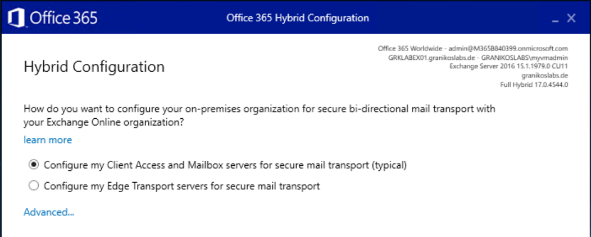
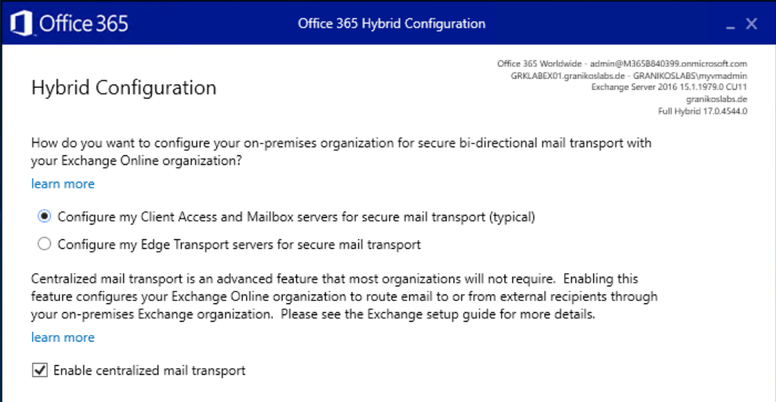
Hybrid Configuration Wizard
Configure hybrid mail flow
Direct to/from internal Exchange Servers
Via Edge Transport Servers in perimeter network, already subscribed to Active Directory site
Centralized mail flow
Route all mail flow to/from Exchange Online mailboxes via on-premises Exchange Organization

Slide 41
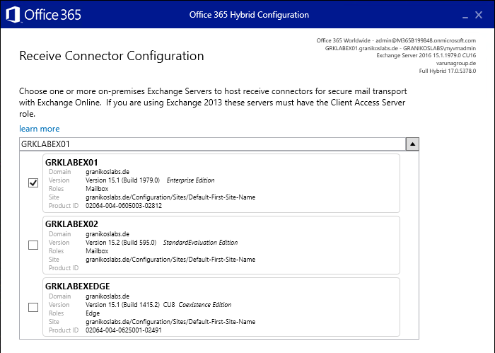
Hybrid Configuration Wizard
Select the Exchange server used for receiving email messages from Exchange Online
Select the Exchange Server published to the Internet
HCW configures the default frontend receive connector

Slide 42
Hybrid Configuration Wizard
HCW might select the wrong receive connector
You use additional receive connectors with a remote IP address range 0.0.0.0 – 255.255.255.255
The default frontend connector uses individual remote IP address ranges configuration
Compare TlsCertificateName and TlsDomainCapabilities connector properties afterwards

Slide 43
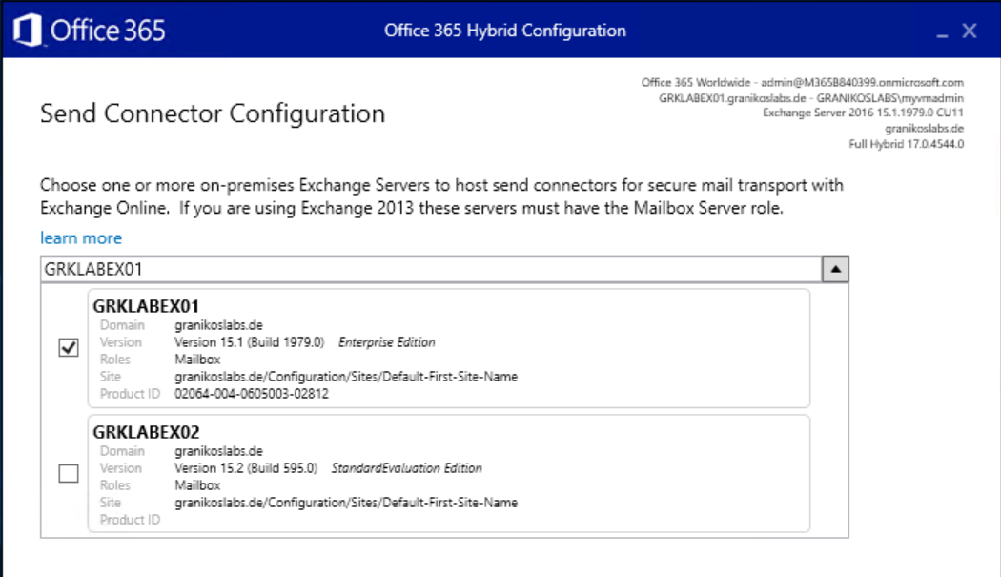
Hybrid Configuration Wizard
Select Exchange server for sending email messages from the on-premises Exchange Organization to Exchange Online
HCW configures Send Connector
Exchange Server needs outbound connectivity to Exchange Online
EdgeSync transfers the Edge Servers’ Send Connector configuration (when using Edge Transport)

Slide 44
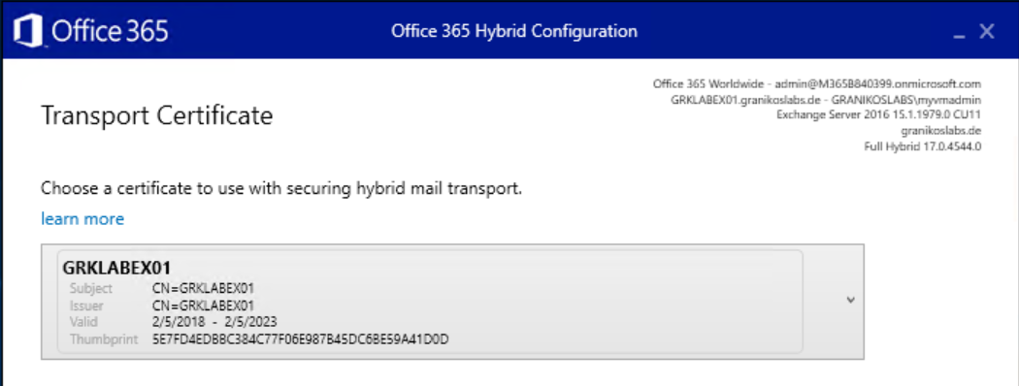
Hybrid Configuration Wizard
Select TLS certificate to secure the trusted mail flow between on-premises Exchange and Exchange Online

Slide 45
Hybrid Configuration Wizard
With Edge Transport
Ensure that the dedicated TLS certificate is installed in the certificate store of one of the internal Exchange servers
Import the TLS certificate prior to executing HCW into the local Exchange Server certificate store
Do NOT enable the TLS certificate for any Exchange service
Avoid using NAT between Edge Transport Servers and internal Exchange servers
Do NOT use TLS intercepting SMTP proxy servers

Slide 46
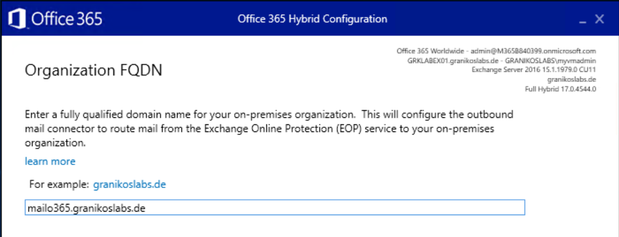
Hybrid Configuration Wizard
Enter the external FQDN of the Exchange Organization for inbound SMTP
Hostname should match TLS certificate
Hybrid mail flow requires Exchange to Exchange communication
Recommendation for centralized mail flow
Use a dedicated host name, IP address, and TLS certificate
Use Edge Transport Server(s)

Slide 47
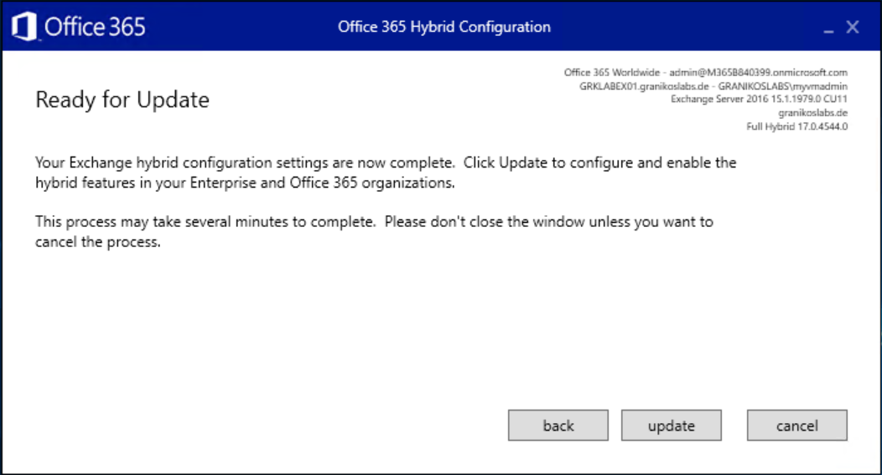
Hybrid Configuration Wizard
Update and wait
If updating fails
HCW provides full log files %appdata%\Roaming\Microsoft\Exchange Hybrid Configuration
Log file contains all PowerShell configuration steps
Use Remote Connectivity Analyzer to check inbound connectivity
Issues
Remote connectivity → Firewall policies, proxy servers, DNS
WinRM Windows service configuration issues

Slide 48
Configuring Exchange Hybrid is simple, isn't it?

Slide 49
Questions?

Slide 50
Microsoft Teams and Exchange Server

Slide 51
Microsoft Teams & Exchange
Microsoft Teams Client communicates with Teams Backend-Services, not with Exchange directly
Microsoft Teams Backend contacts Exchange Online first
If user mailbox is not in Exchange Online, the Teams Backend receives an HTTP 302 redirect to on-premises
On-premises endpoint is always discovered using AutoDiscover v2
Exchange Redirect requires AAD Connect synchronization with Exchange Hybrid option enabled

Slide 52
Microsoft Teams & Exchange
Authentication requires OAuth between Exchange Server and Exchange Online / Azure AD
Use Hybrid Configuration Wizard
Microsoft Teams Backend requires communication with AutoDiscover, EWS, and REST endpoints

Slide 53
Microsoft Teams & Exchange
When using many different SMTP domains you need a dedicated AutoDiscover v2 endpoint for each domain
Microsoft Teams backend services do not handle an on-premises HTTP 302 redirect correctly
Publish an AutoDiscover endpoint for each SMTP domain
Use an edge router if you cannot add all domains to a single SAN certificate, e.g., Traeffic

Slide 54
Microsoft Teams & Exchange
Check Microsoft Teams coexistence mode with Skype for Business Online
Only Island, Teams Only, or Skype for Business with Teams Collaboration and Meeting support the calendar tab
Verify that the calendar tab is enabled in Teams App Policy
Ensure that Exchange Hybrid is enabled in Azure AD Connect

Slide 55
Questions?

Slide 56
Demo slide
Demo title

Slide 57








Thank you sponsors & partners!

Slide 58


Thomas Stensitzki
MCT Regional Lead
MVP Microsoft 365 Apps & Services
linktr.ee/stensitzki

Slide 59
Resources
Exchange Server Hybrid Deployments
Hybrid Deployment Prerequisites
Hybrid Configuration Wizard FAQs
Configuring Teams calendar access for Exchange on-premises mailboxes
Configure OAuth authentication between Exchange and Exchange Online organizations
Demystifying and troubleshooting hybrid mail flow: when is a message internal?
Remote Connectivity Analyzer
How Exchange and Microsoft Teams interact
Traeffic Edge Router

